Slide 1
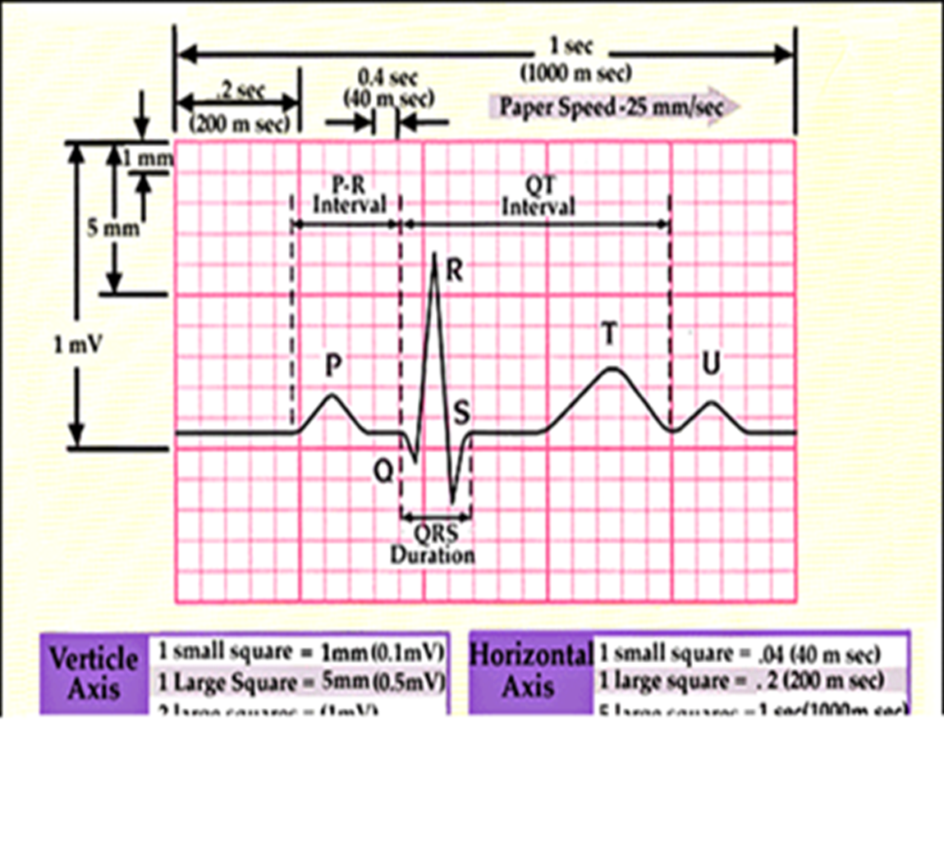

Slide 2
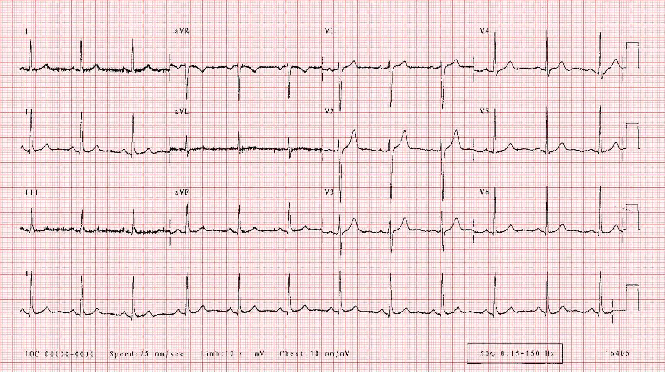
?

Slide 3
Normal

Slide 4
Axis?

Slide 5
LAD: QRS positive in lead I and negative in II & aVF leads
RAD: QRS negative in lead I and positive in aVF leads

Slide 7
?

Slide 8
Sinus tachycardia

Slide 9
?

Slide 10
Atrial Fibrillation with RVR

Slide 11
?

Slide 12
LBBB
1. QRS duration of > 120 milliseconds.
2. Absence of Q wave in leads I, V5, and V6.
3. Monomorphic R wave in I, V5, and V6.
4. ST and T wave displacement opposite to the major deflection of the QRS complex.

Slide 13
?

Slide 14
RBBB
1. QRS duration of > 120 milliseconds
2. rsR' "bunny ear" pattern in precordial leads
3. Slurred S waves in leads I, aVL and frequently V5 and V6.

Slide 15
?

Slide 16
First Degree AV Block

Slide 17
?

Slide 18
2nd Degree AV Block (Wenkebach)
Inferior ST Elevation Myocardial Infarction

Slide 19
?

Slide 20
2nd Degree AV Block (type II, Mubitz)

Slide 21
?

Slide 22
2nd Degree AV Block - 2:1 Block

Slide 23
?

Slide 24
Third Degree AV Block

Slide 25
?

Slide 26
Ventricular Tachycardia
Nonsustained VT refers to short episodes (<30 seconds) that revert spontaneously, whereas sustained VT refers to more prolonged episodes

Slide 27
?

Slide 28
Ventricular Fibrillation

Slide 29
?

Slide 30
Idioventricular rhythm

Slide 31
?

Slide 32
Asystole

Slide 33
?

Slide 34
Inferior ST Elevation Myocardial Infarction

Slide 36
Anterior ST Elevation Myocardial Infarction

Slide 37
?

Slide 38
Inferior&Posterior ST Elevation Myocardial Infarction

